Slide 1

Bapuji Educational Association ® BAPUJI INSTITUTE OF ENGINEERING AND TECHNOLOGY DAVANGERE, KARNATAKA-577004 DEPARTMENT OF COMPUTER SCIENCE AND ENGINEERING
Intra\Internship project on
BIKE RENTALS
Team Members:
Amrutha M Banakar 4BD21CS010
Abdulkhadar 4BD22CS400
Kartik R 4BD22CS408
Varshitha 4BD21CS174
Vijetha N 4BD21CS177
Intra\Internship co-ordinators:
Prof Gangadharappa S
Associate Professor
Dr. Naresh Patel KM
Asociate Professor
Head of department:
Dr. Nirmala C.R
Professor and Head,
CSE

Slide 2
Vision and Mission of the Department
Vision “To be a centre-of-excellence by imbibing state-of-the-art technology in the field of Computer Science and Engineering, thereby enabling students to excel professionally and be ethical.” Mission 1.Adapting best teaching and learning techniques that cultivates Questioning and Reasoning culture among the students. 2.Creating collaborative learning environment that ignites the critical thinking in students and leading to the innovation. 3.Establishing Industry Institute relationship to bridge the skill gap and make them industry ready and relevant. 4.Mentoring students to be socially responsible by inculcating ethical and moral values.

Slide 3
INDEX
Introduction
Internship syllabus
Technologies used
( Hardware requirements
Software requirements)
Snap shots
Summary

Slide 4
Introduction
Bike rental site is a online site for renting bikes.
Bike rentals site is a modern solution for transportation issues around the cities.
It is designed to give an easy access and for wide range of selection of bikes.
This project was developed through the skills acquired during our Internship.

Slide 5
HTML
HTML tags are like keywords which defines that how web browser will format and display the content. With the help of tags, a web browser can distinguish between an HTML content and a simple content.
Syntax: <tag> content </tag>
Example of HTML tags:
Heading tag <h1>……</h2>
Paragraph tag<p>……</p>
Bold, italic, underline tag <b>…</b>, <i>…</i>, <u>…</u>
Break tag <br>…..</br>
Anchor tag <a href=“ ”>….</a>
Image tag <img src=“ ”>….</img>
Div tag <div>…..</div>

Slide 6
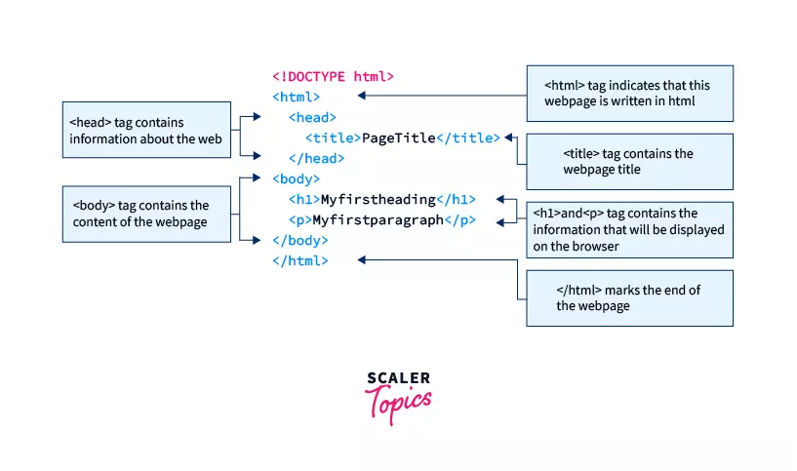
Elements to layout an HTML web page

Slide 7
CSS
CSS stands for Cascading Style Sheets
CSS describes how HTML elements are to be displayed on screen
A CSS selector selects the HTML elements we want to style.
Javascript
Javascript is an interpreted, full-fledged programming language that enables dynamic
interactivity on websites when applied to an HTML document.
JavaScript follows the syntax and structure of the C programming language. Thus, it is a structured programming language.
JavaScript is used to create interactive websites. It is mainly used for:
Client-side validation,
Dynamic drop-down menus,
Displaying date and time,
Displaying pop-up windows and dialog boxes (like an alert dialog box, confirm dialog box),
Displaying clocks etc.

Slide 8
Basics of Java
Basics of java which include keywords,identifiers and operators.
Control statements of java which include decision statements, looping, break and continue.
Object Oriented Concepts:
Inheritance: When one object acquires all the properties and behaviours of a parent object, it is known as inheritance. It provides code reusability. It is used to achieve runtime polymorphism.
Abstraction: If one task is performed in different ways, it is known as polymorphism. In Java, we use method overloading and method overriding ton achieve polymorphism.
Encapsulation: Data Abstraction is the property by virtue of which only the essential details are displayed to the user. The trivial or non-essential units are not displayed to the user.

Slide 9
My SQL
Polymorphism: It is defined as the wrapping up of data under a single unit. It is the mechanism that binds together the code and the data it manipulates.
Introduction to MySQL
MySQL is a widely used relational database management system (RDBMS).
MySQL is free and open-source.
MySQL is ideal for both small and large applications.
SQL commands:
SQL commands are instructions.
It is used to communicate with the database.
It is also used to perform specific tasks, functions, and queries of data.

Slide 10
SQL clauses
SQL clauses are keywords used to perform specific actions within SQL statements.
Select: Used to specify the columns you want to retrieve data from.
FROM: specifies the table or tables from which to retrieve data.
Where: filters records based on specified conditions.
Group by: groups rows that have the same values into summary rows.
Having: specifies a condition for groups of rows returned by a group by clause.
Order by: sorts the result set in ascending or descending order.
Join: combines rows from two or more tables based on a related column.
Union: combines the results of two or more select statements.

Slide 11
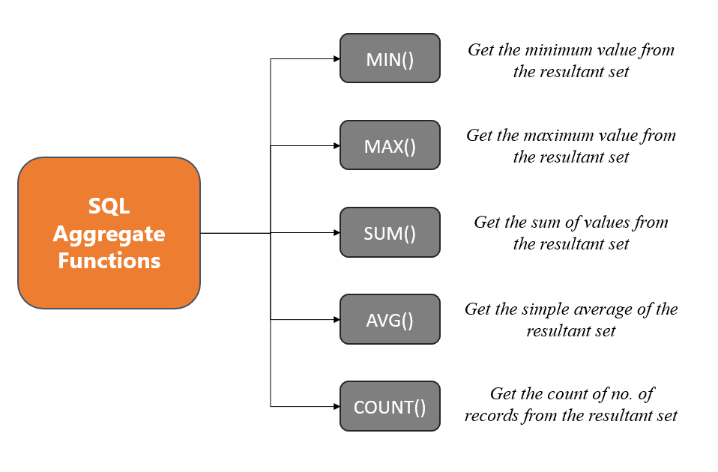
SQL Aggregate Functions

Slide 12
Technologies used:
Software requirements
Front End :
User interface : HTML/CSS/JavaScript•Operating System : Microsoft Windows 7 or above•Web Browser : Chrome, Internet Explorer
Back End:
Programming Language :java/J2EEJavaScript
Database: My SQL
Application Server:XAMPP server for Apache server and servlet
Eclipse

Slide 13
Hardware Requirements
Processor : intel i5 or above
Hard disk : 30gb, RAM : 4gb or Above
Display Resolution : 1366 x 768 (1920 x 1080 Recommended).
Other standard physical devices like keyboard, mouse etc

Slide 14
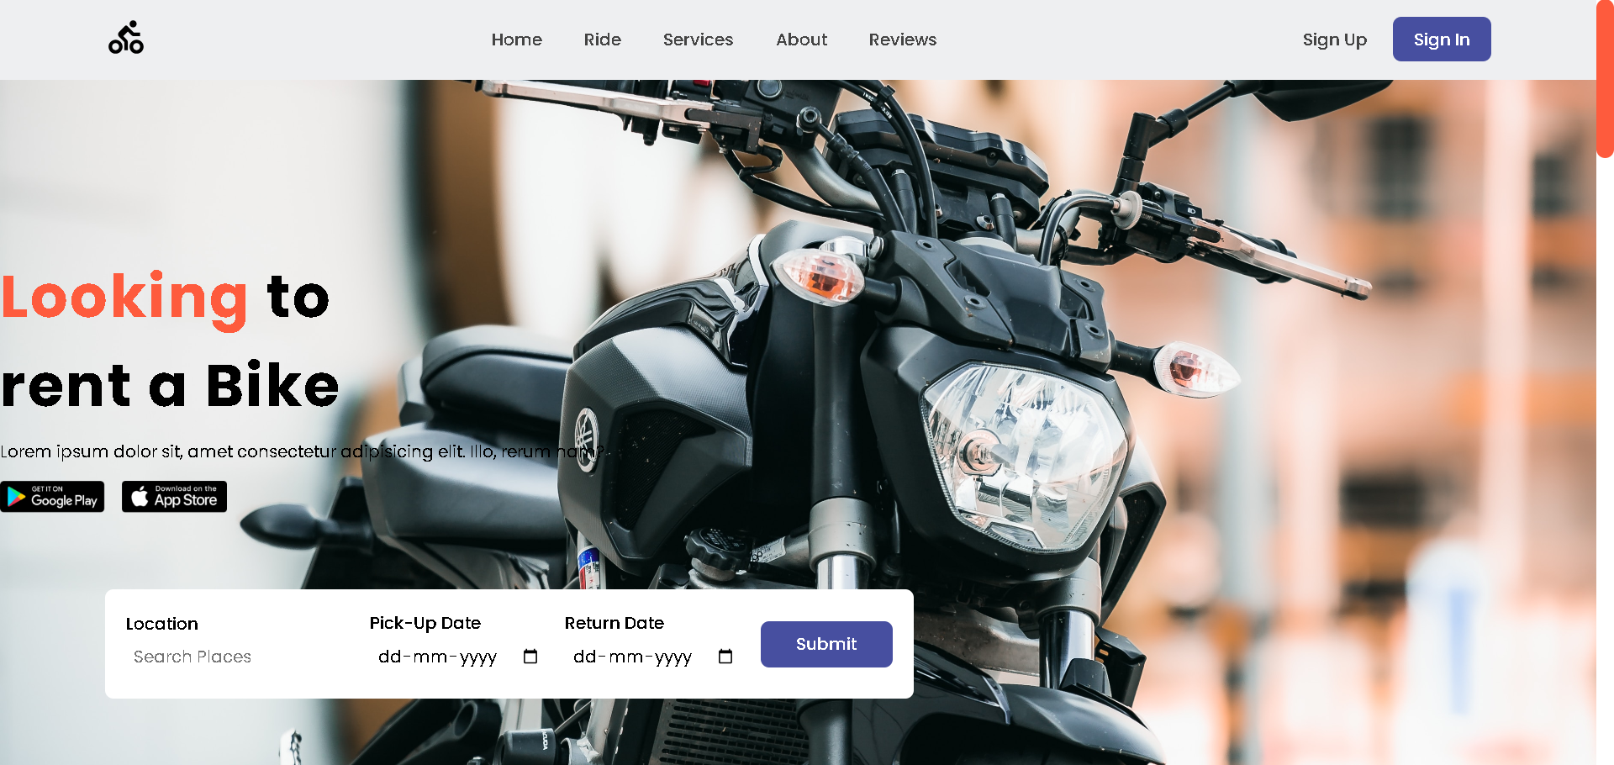
Snap shots
1.Home page
Fig 1. Homepage of the application
Existing user can login or can register as a new user. It also provides Admin Login

Slide 15
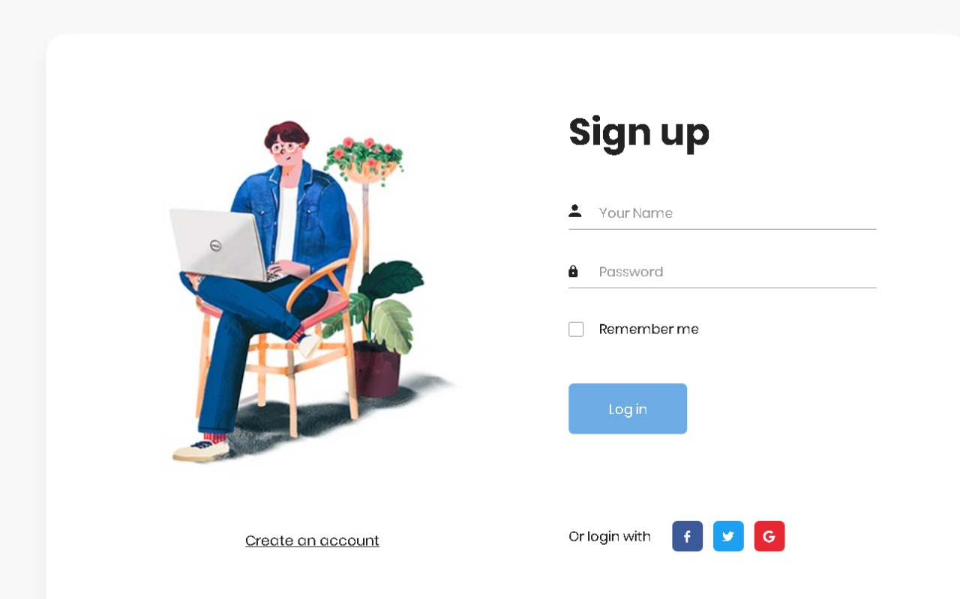
2.Login page
Fig 2.Login page for User login

Slide 16
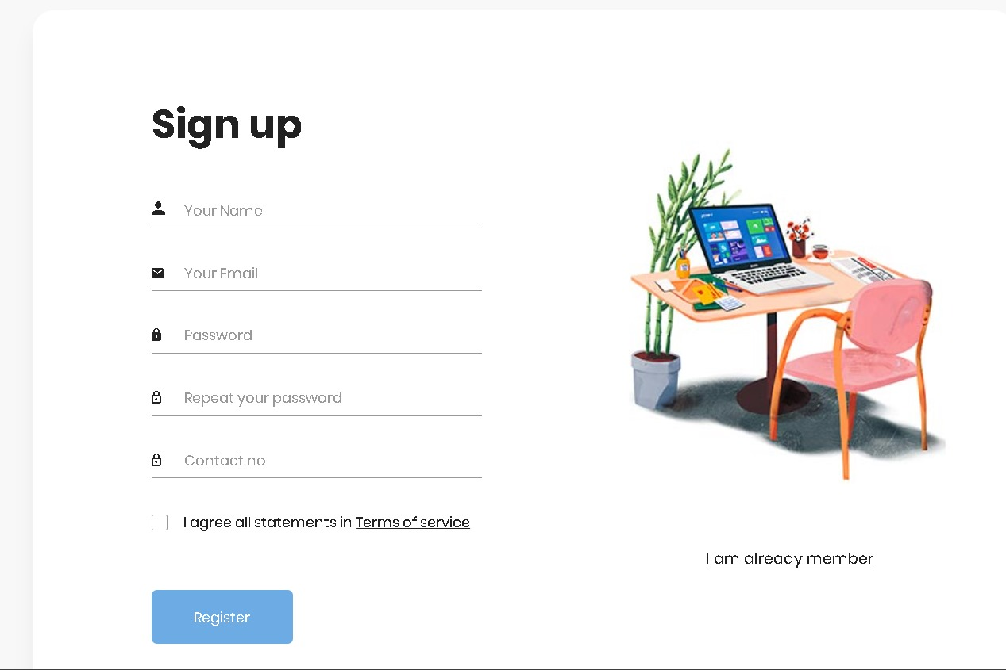
2.Login page
Fig 2.Registration page for User login

Slide 17
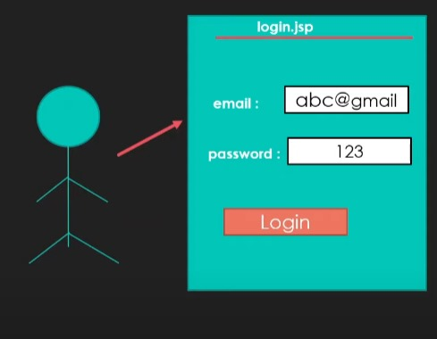
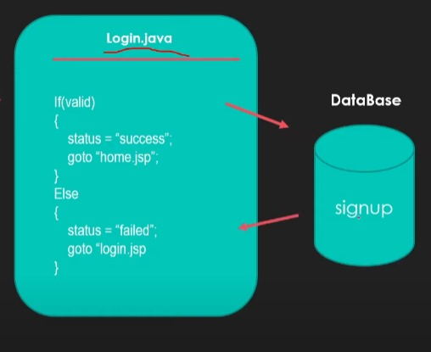
User Login FLow

Slide 18
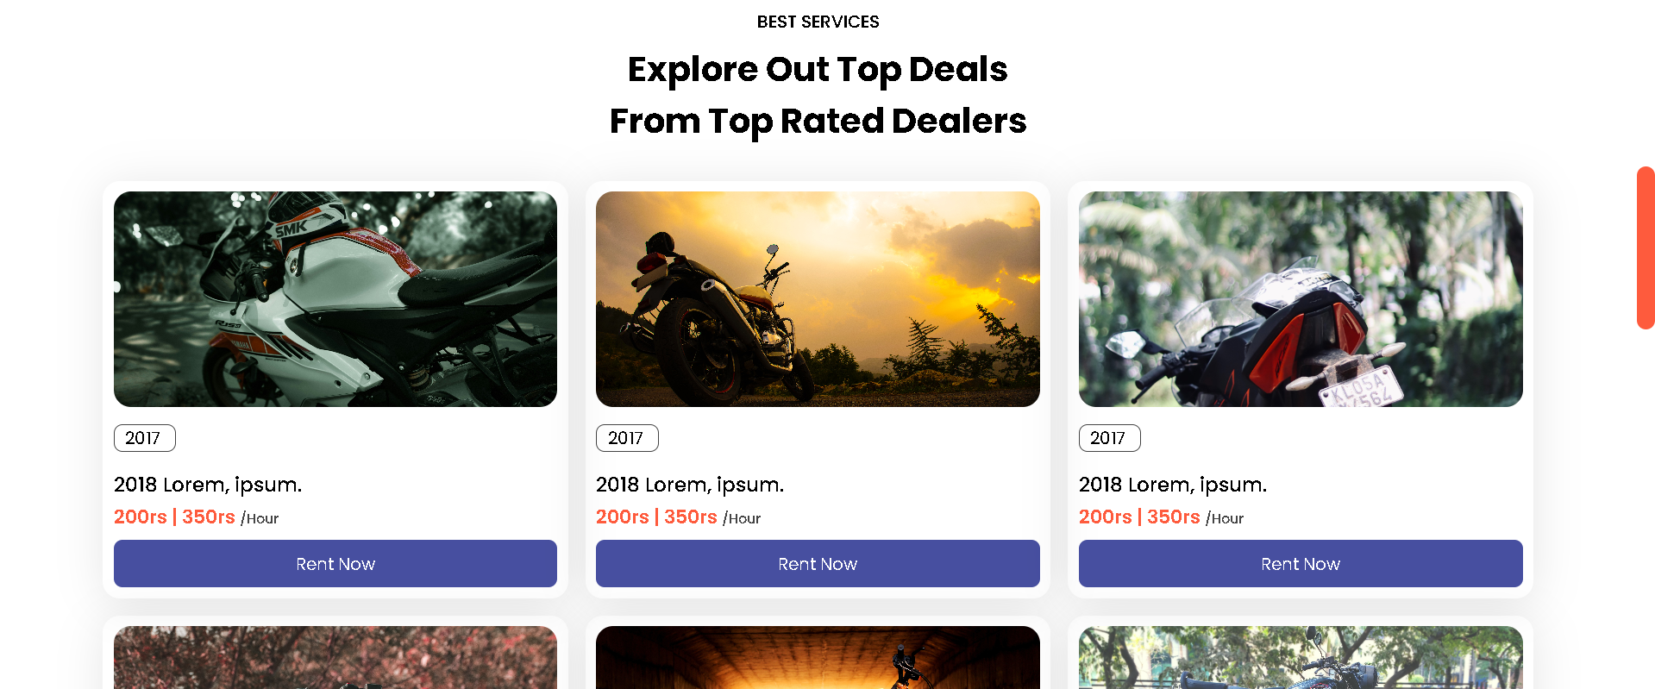
3.Bike selection
Fig 3. Search result page where user makes a selection

Slide 19
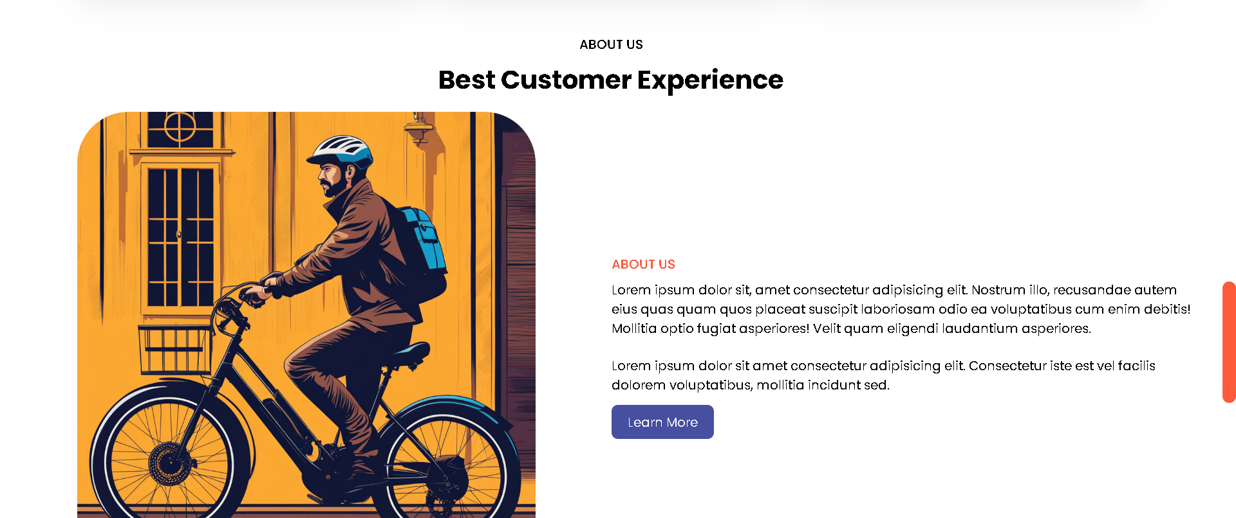
4.About page
Fig 4.about homepage

Slide 20
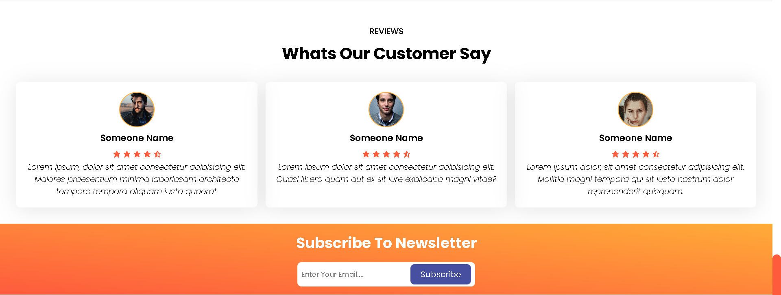
5.Review page

Slide 21
Conculsion
Bike Rental System is a website and it is restricted to only limited type of users. In this application, Admin have been given access rights and are restricted up to certain functionalities, so that the data is maintained securely and redundant data is prevented. As the Data is stored electronically, it is necessary to have a Computer and Network connection to access the Application. This is a software which helps the user to rent bike base on their need and it reduces the amount of manual data entry and gives greater efficiency. The User Interface of it is very friendly and can be easily used by anyone. It also decreases the amount of time taken to write details and other modules. At the end, this software can perform all the tasks accurately and can do the work for which it is made.

Slide 22
Thank You

